Slide 1
Travelling Buddy
Your Ultimate Companion for Safe and Memorable Adventures
Made By : Mahnoor Babar
In a world where travel is more accessible than ever, finding the right companion to share your journey can make all the difference. Enter Travelling Buddy—an innovative app designed to connect travelers with like-minded individuals, ensuring that every adventure is safe, enjoyable, and unforgettable.

Slide 2
Introducing the Travelling Buddy
Travelling Buddy connects travelers with like-minded individuals, enabling them to form travel groups, plan trips together, and ensure a safer, more enjoyable experience. Whether you're looking to make new friends, split travel costs, or simply have someone to share the journey with, Travelling Buddy is your go-to platform for building meaningful travel connections.

Slide 3

Background
The idea for Travelling Buddy was born out of a common challenge faced by many travelers: the desire to explore the world with others, yet struggling to find suitable travel companions. Whether it’s the difficulty in aligning schedules, finding someone with similar interests, or ensuring safety while traveling with strangers, these issues often deter individuals from fully embracing their travel aspirations.

Slide 4
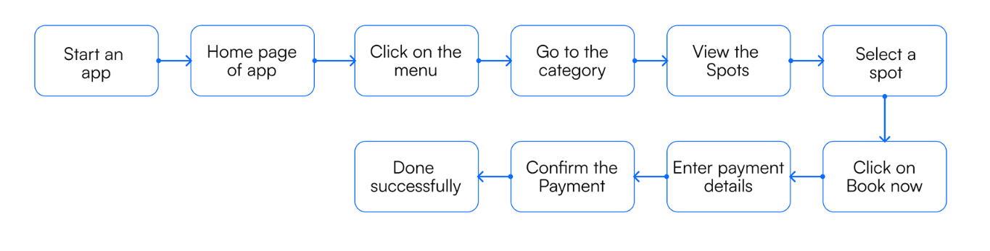
Task Flow

Slide 5
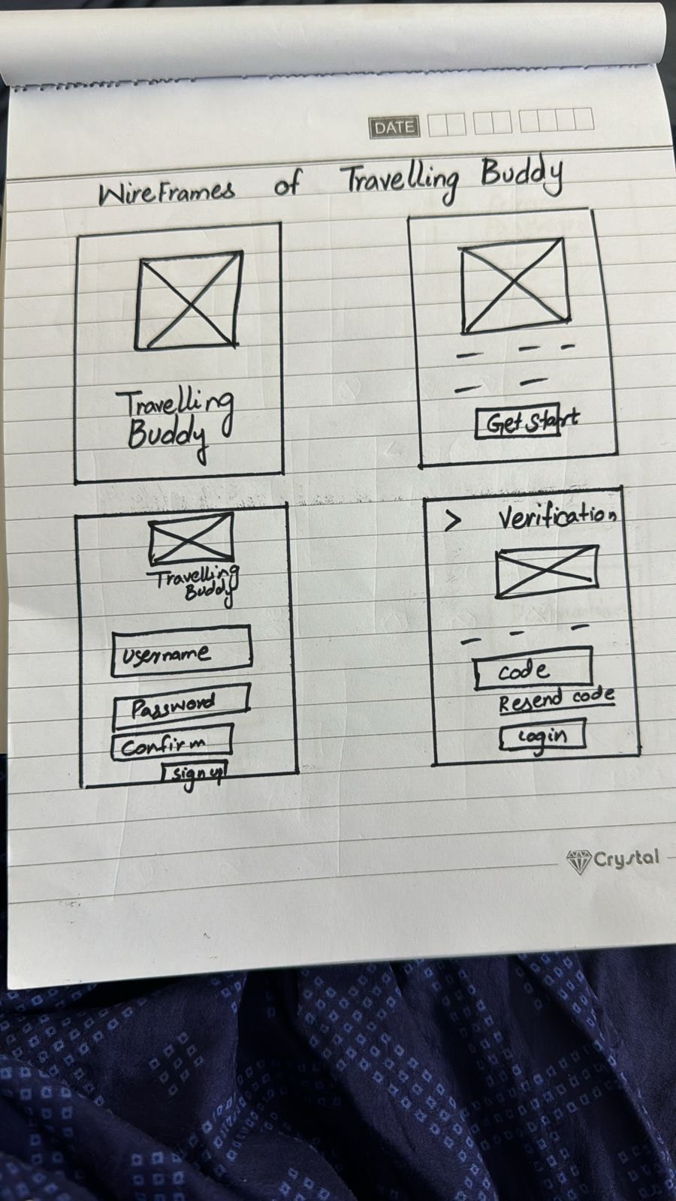
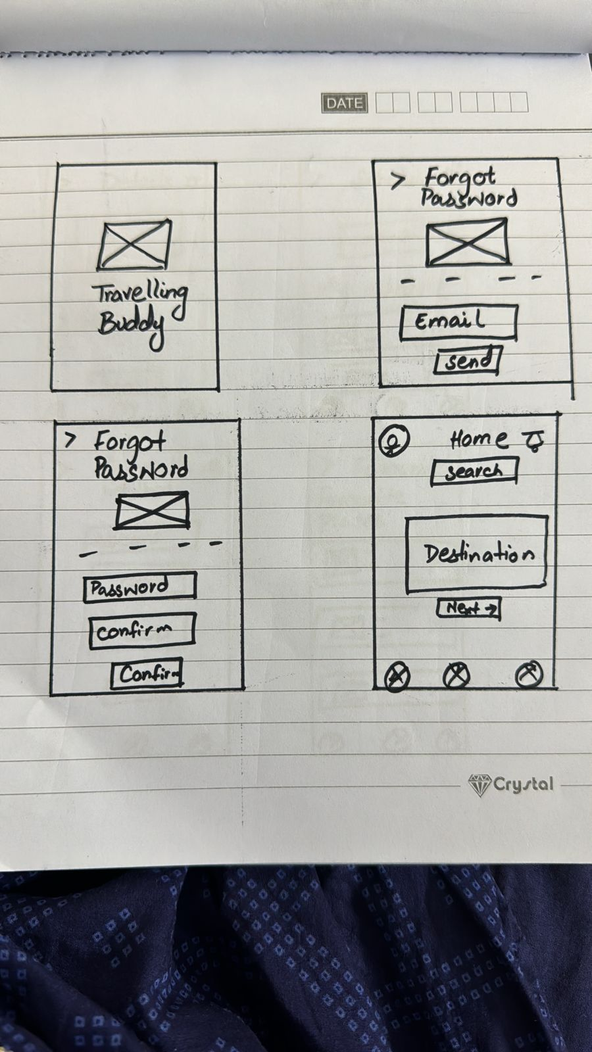
WireFrames

Slide 6
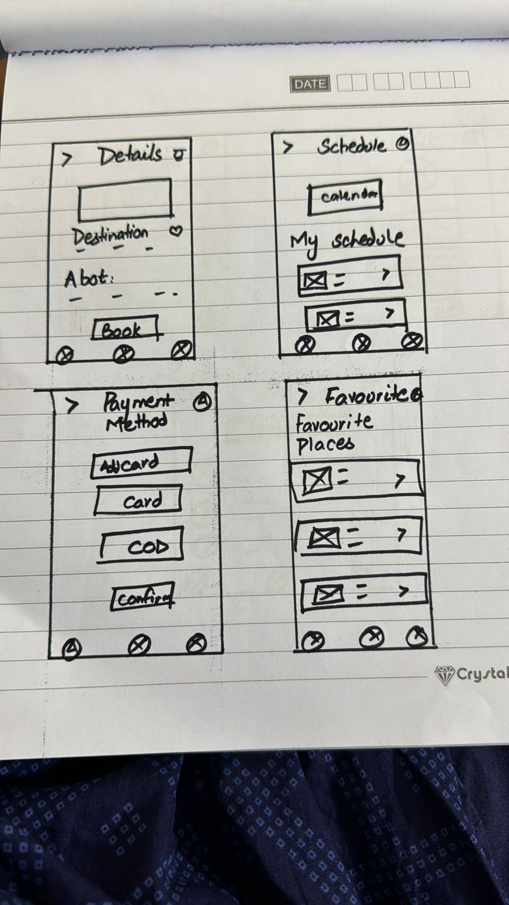
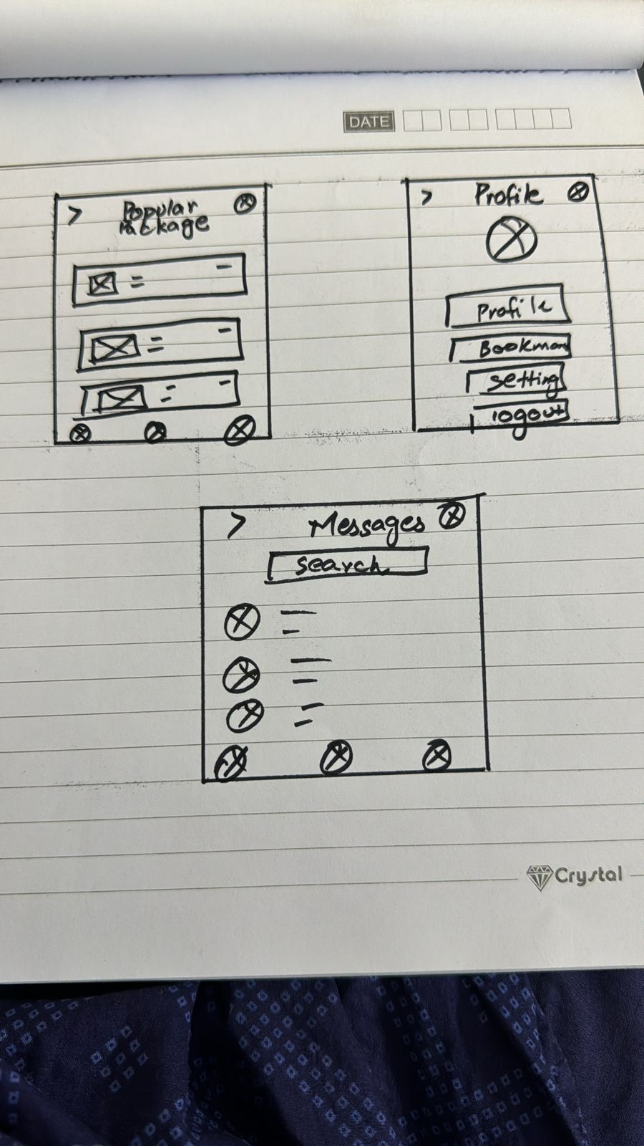
WireFrames

Slide 7
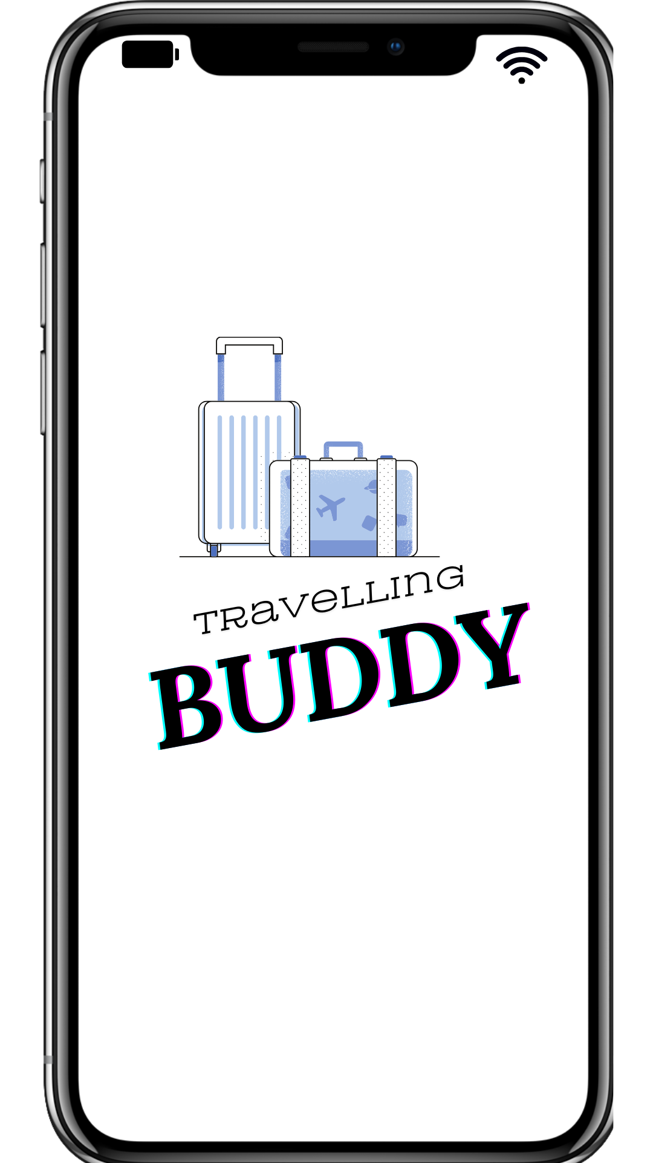
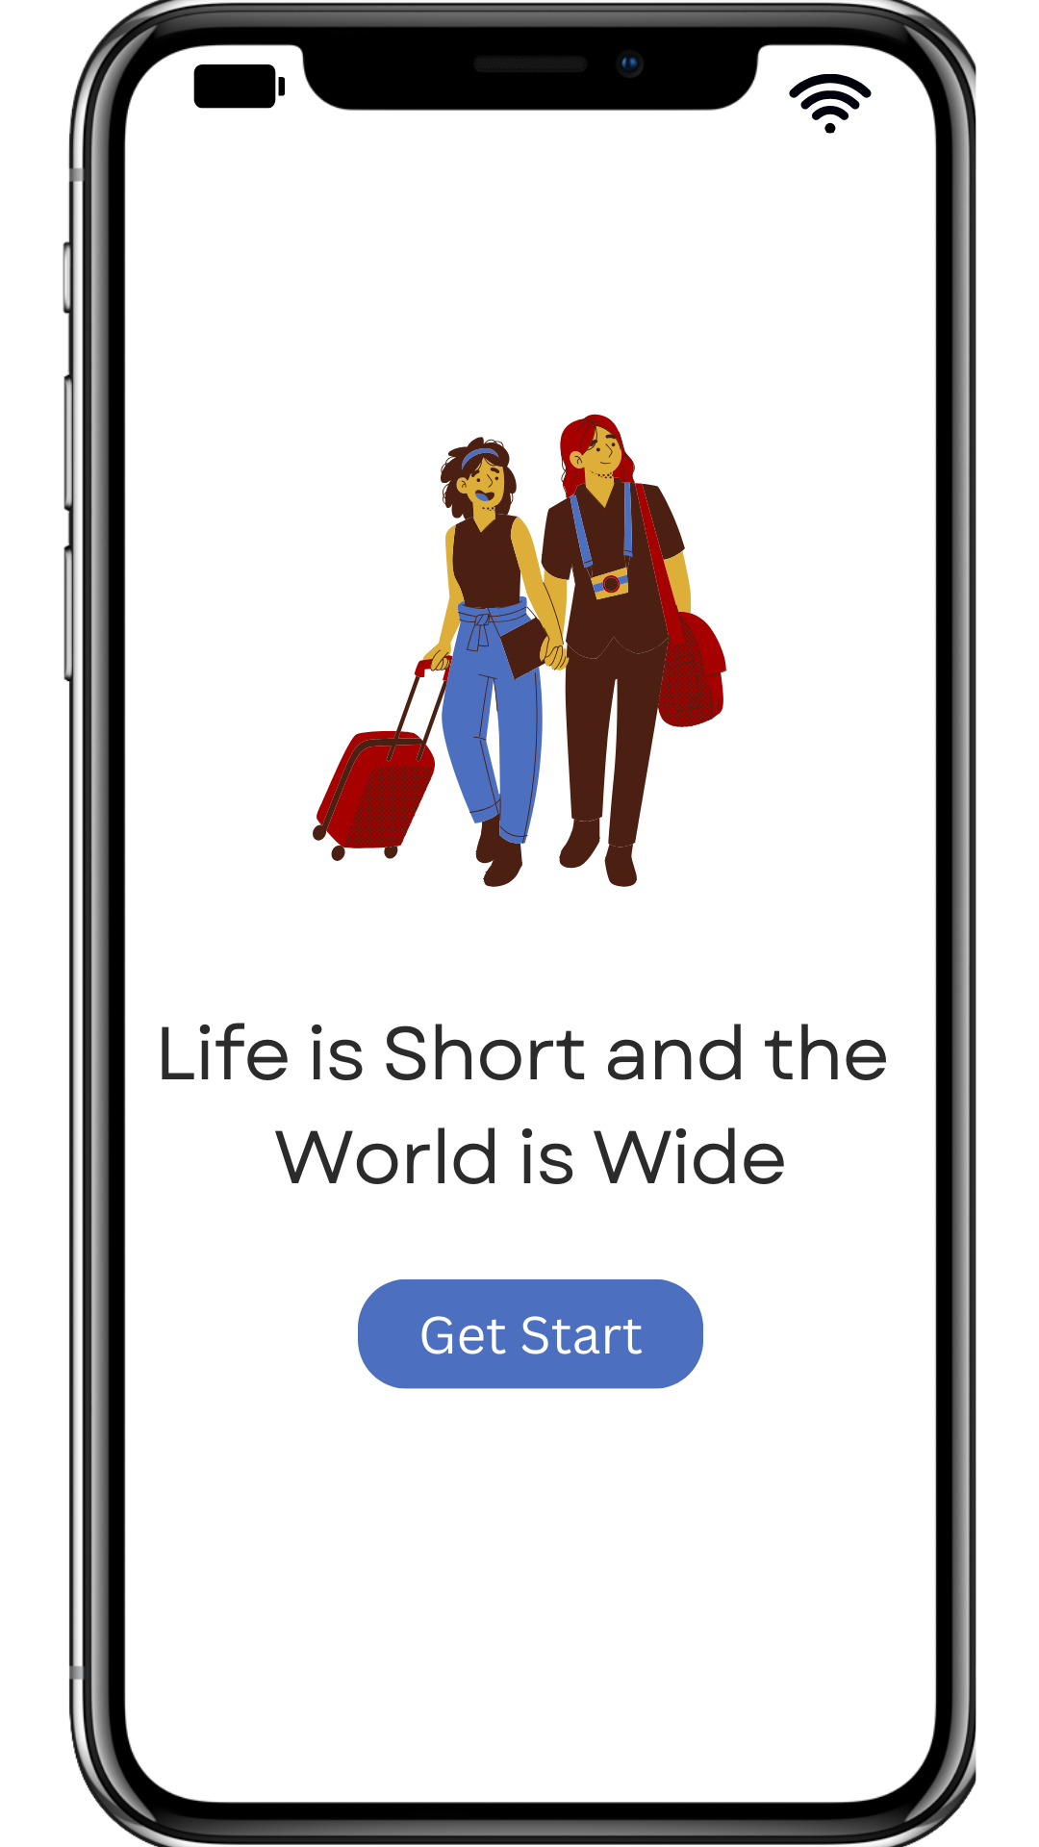
Final Design

Slide 8
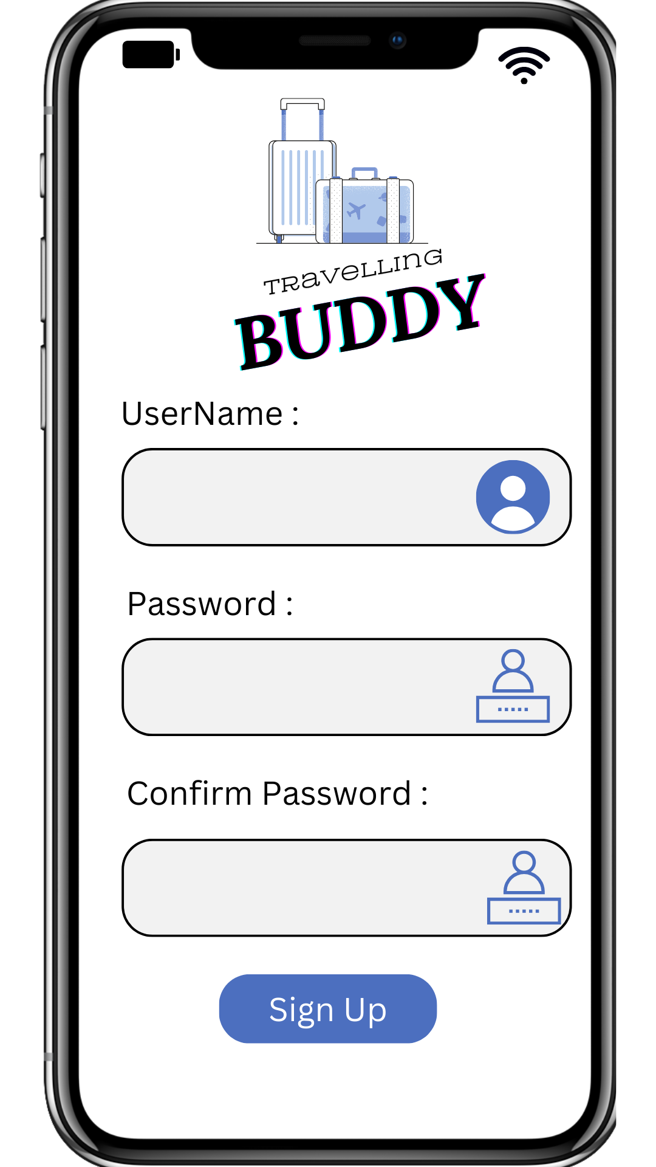
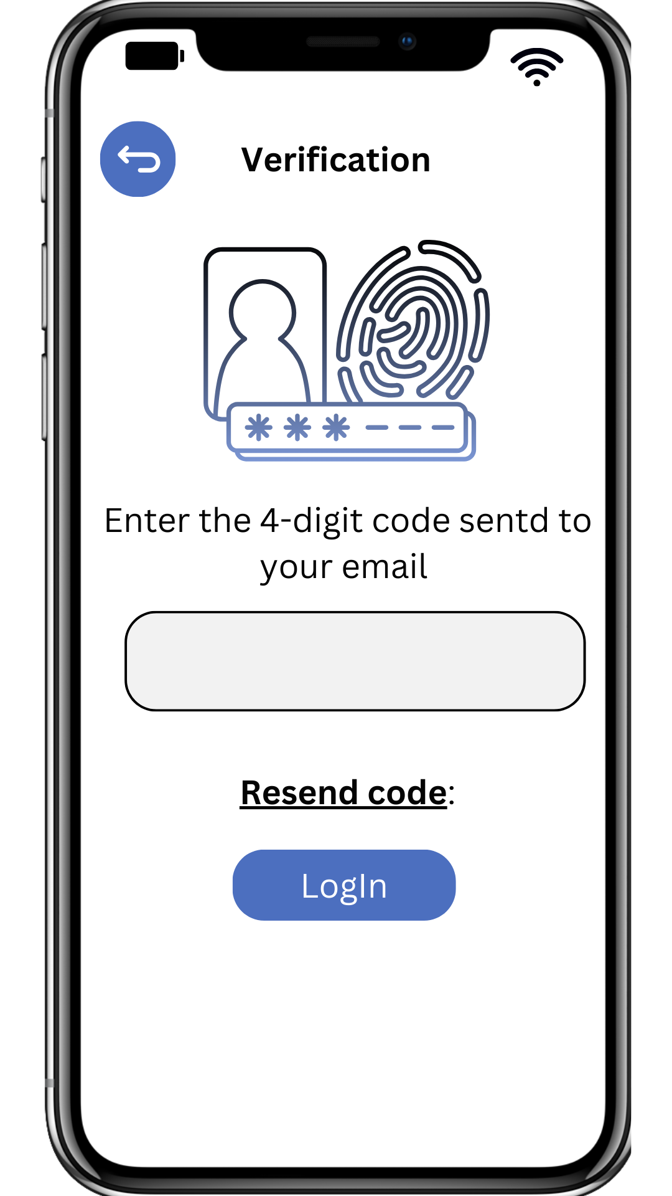

Slide 9
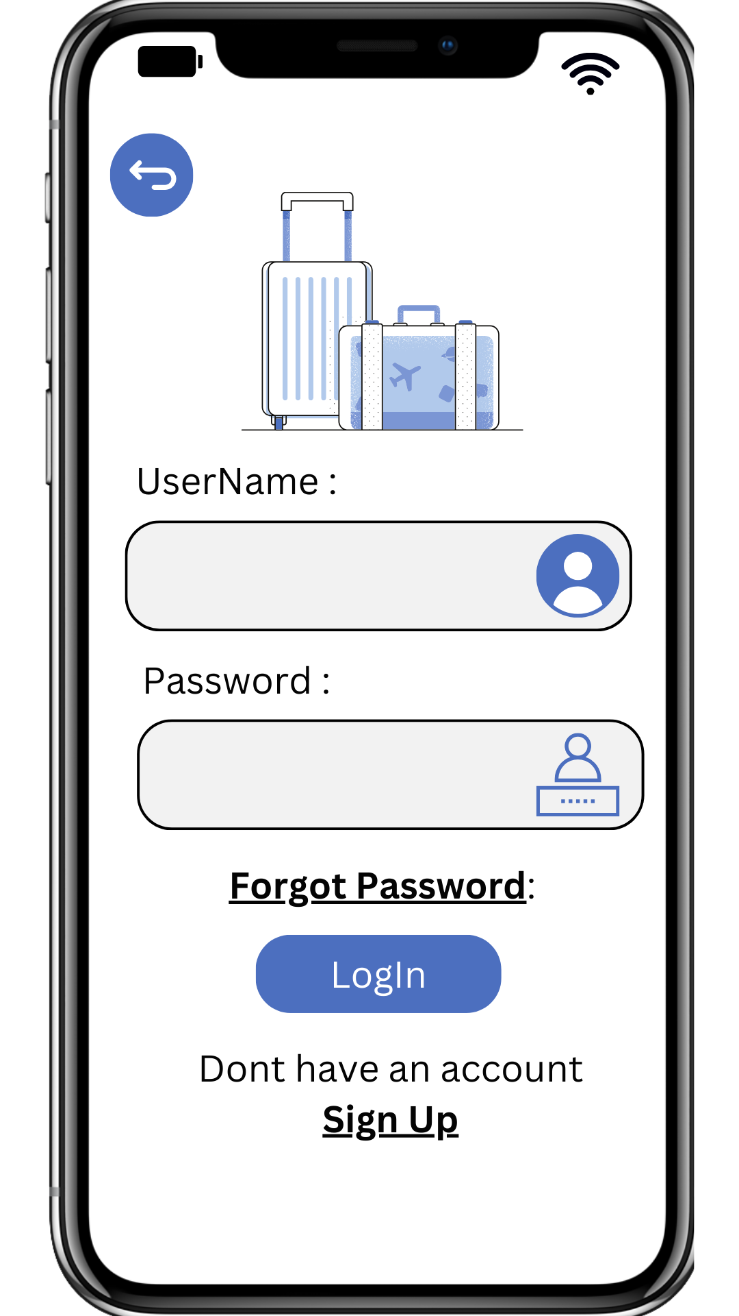
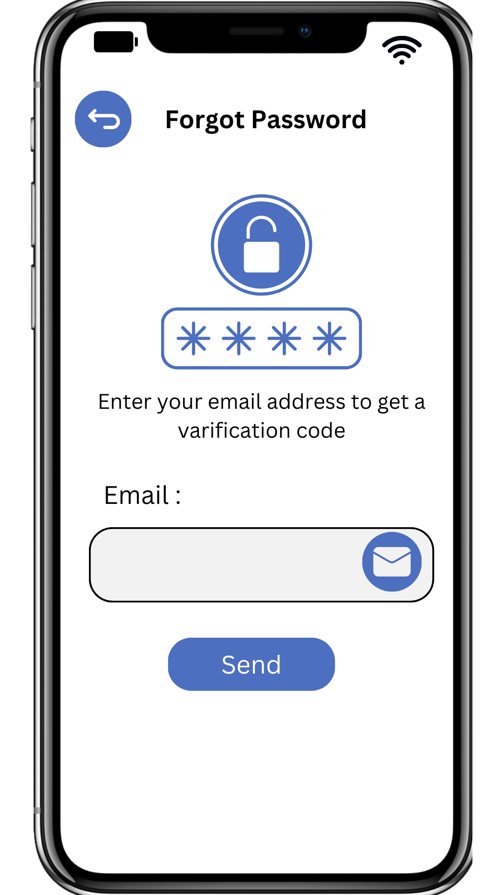
Final Design

Slide 10
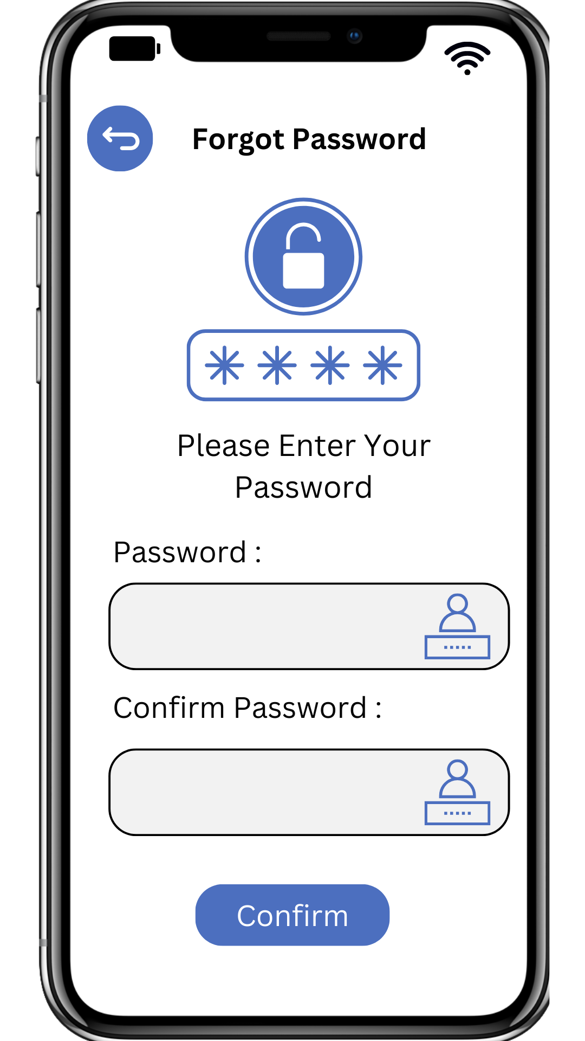
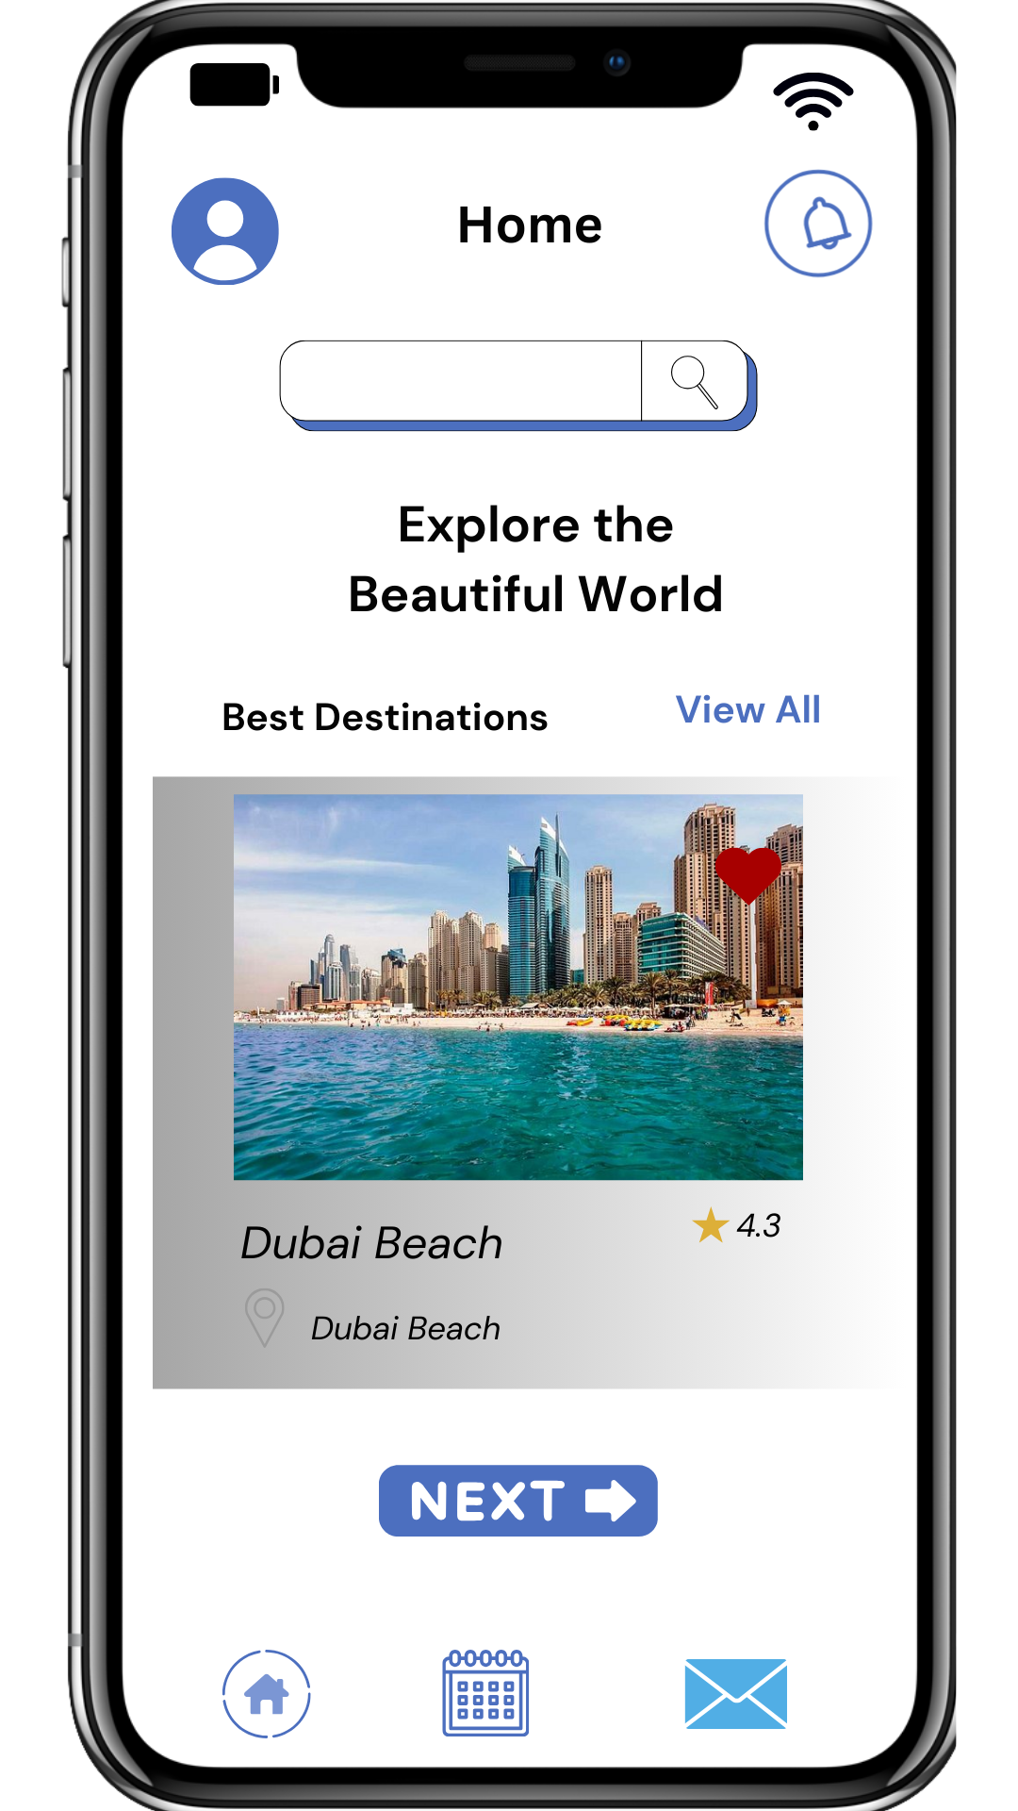
Final Design

Slide 11
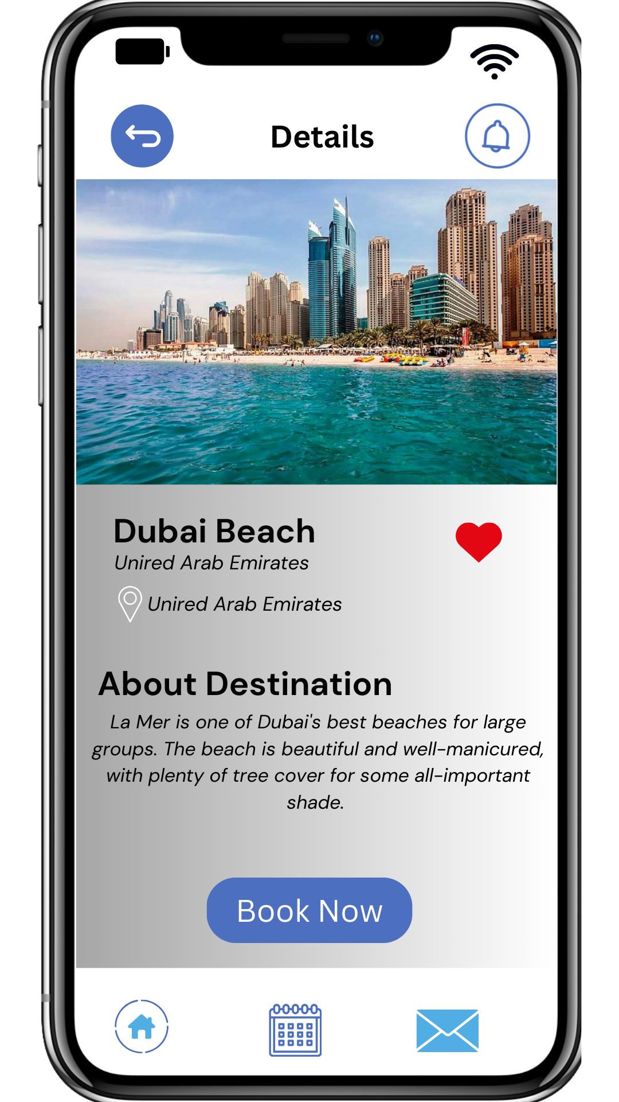
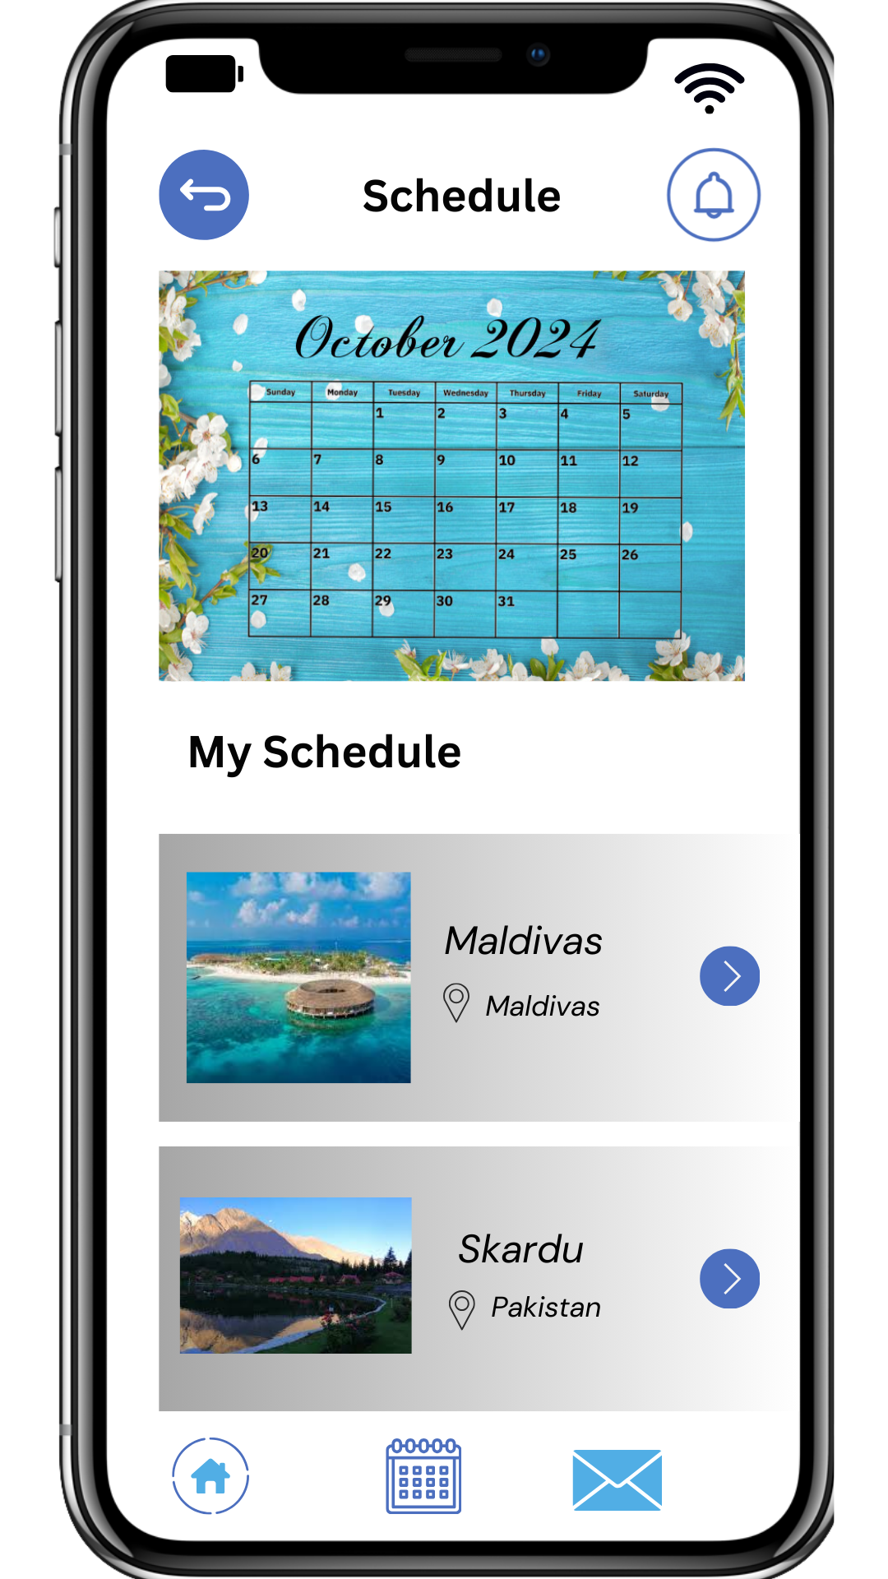
Final Design

Slide 12
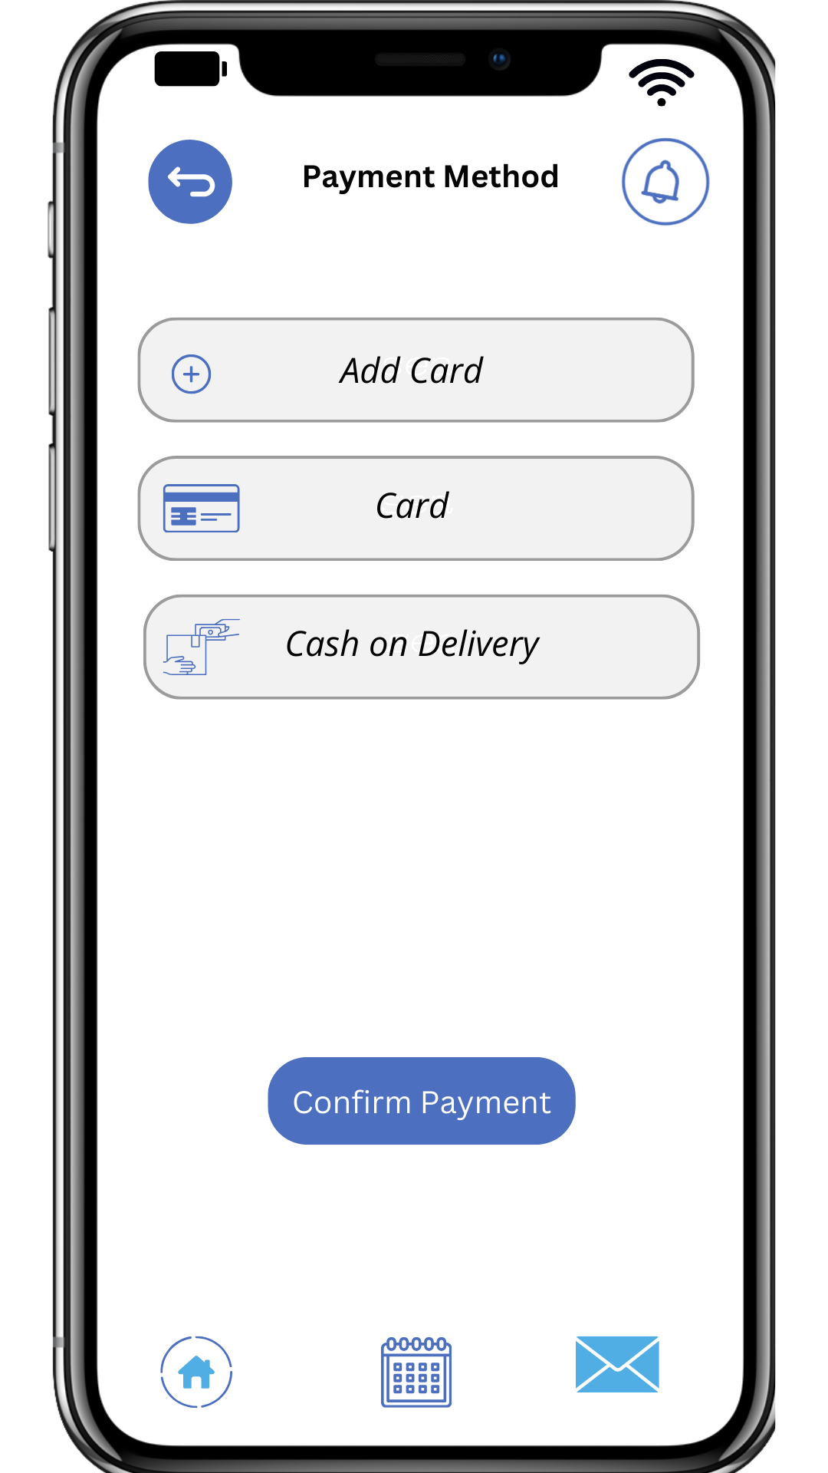
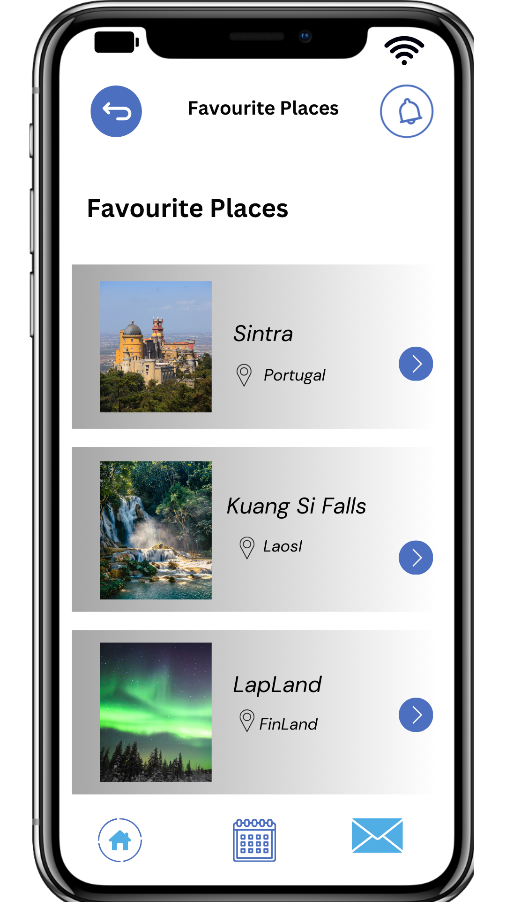
Final Design

Slide 13
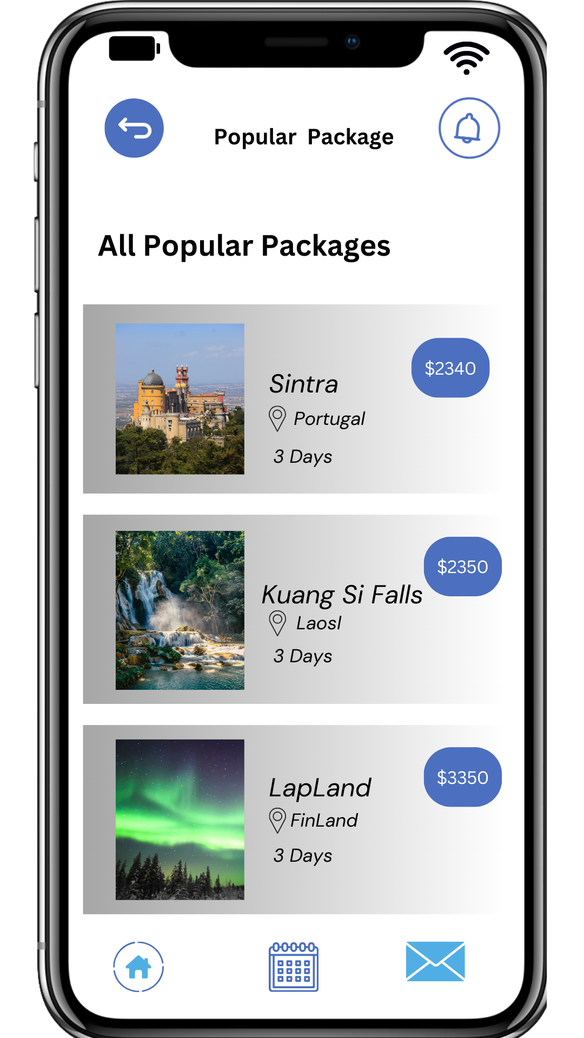
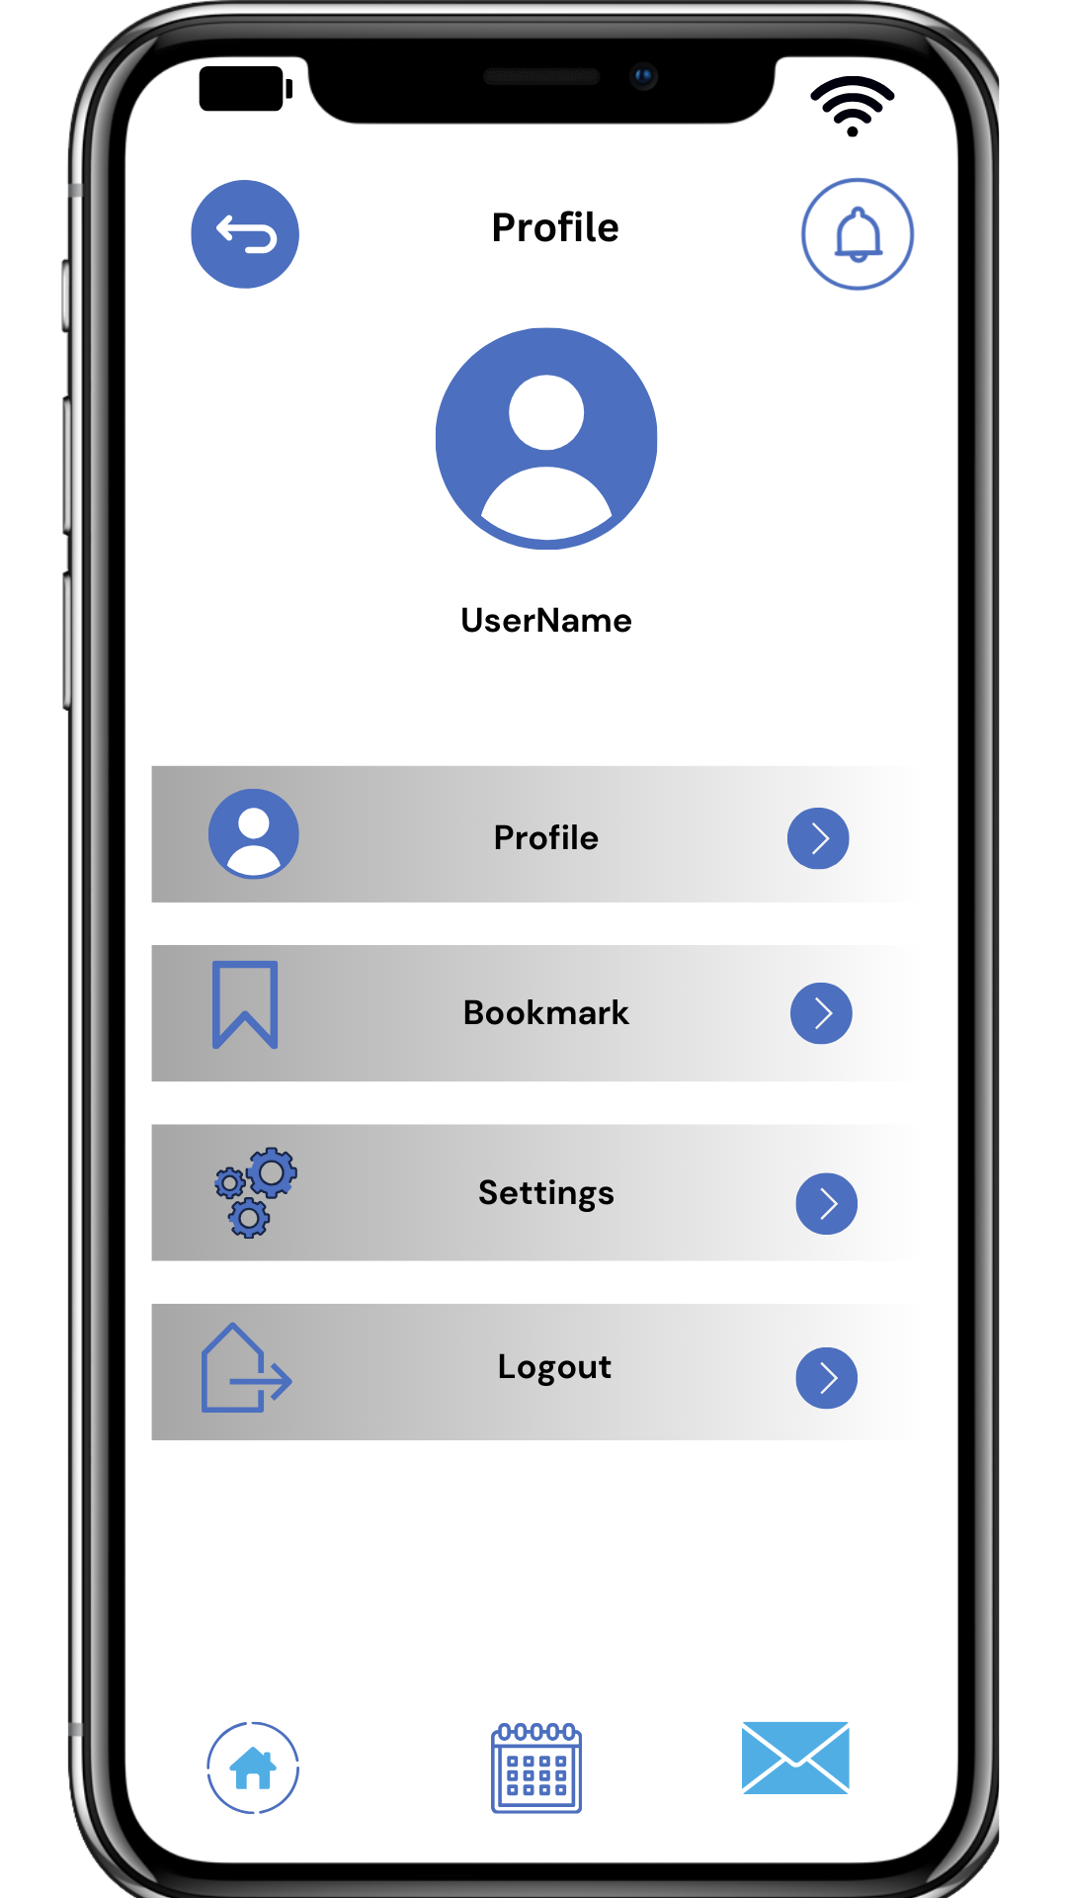
Final Design

Slide 14
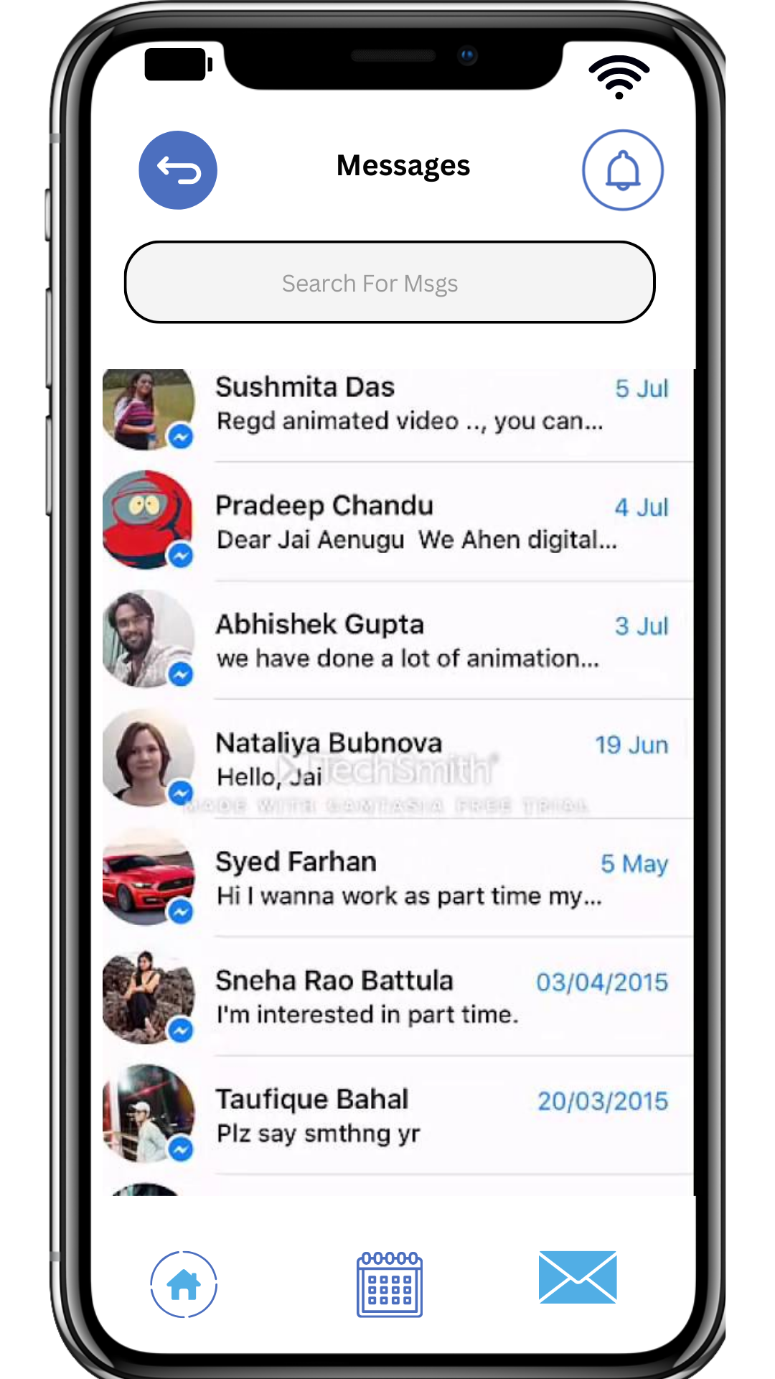
Final Design

